Slide 1
EENG 284 - Lab 8 Datapath + RAM

Slide 2
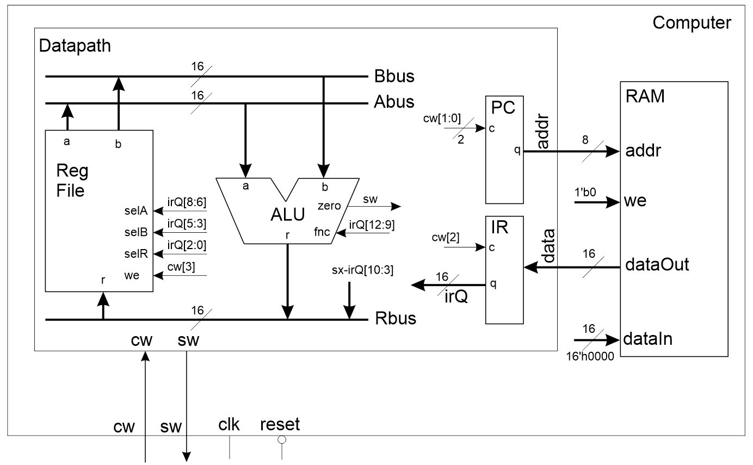
Datapath + RAM
Instructions are stored in RAM
Fetch instructions into IR using address contained in PC
Operation synchronized using control word

Slide 3
RAM
module mainMemoryRAM(addr, clk, dataIn, we, dataOut);
Holds 256 words, hence 8-bit address
Each word is an instruction, hence 16-bits
clk signal synchronizes some operations
Initialized via:
$readmemh("C:/path/file.lst", ramArray);
file.lst contains 16-bit hex values, starting at address 0
Run computer testbench using program from last week

Slide 4
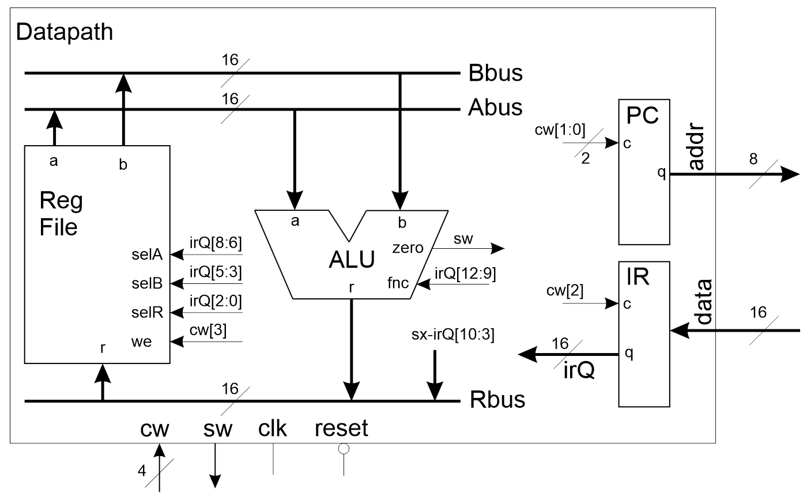
Control Word
Fetch: Load instruction into IR
Execute: Increment PC, Load Rbus into register file

Slide 5
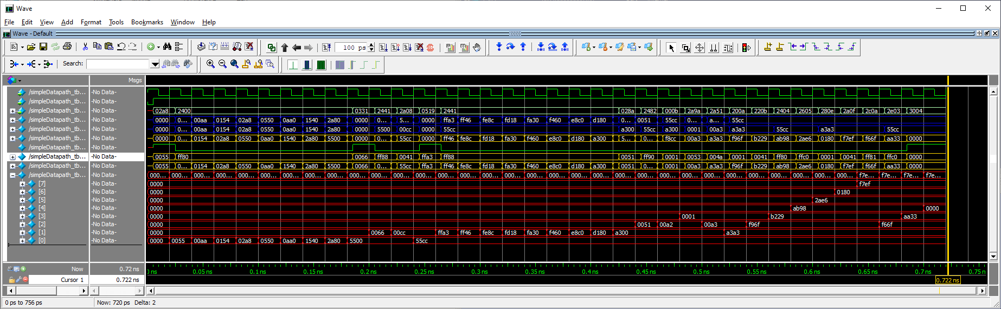
Deliverables
Ram testbench
Modified datapath
Computer testbench – this is last week’s result, same as this week’s

